Slide 1
Handling Logical Errors In React
Logical errors, also known as runtime errors
Involves identifying and correcting errors that arise from incorrect logic within the code
These errors can manifest in various ways, such as unexpected behavior, incorrect data processing, or rendering issues.

Slide 2
To effectively handle logical errors in React, consider the following strategies
Implement Error Boundaries:
Designed to catch errors within their child components, preventing them from affecting the entire application and allowing for the display of a user-friendly fallback UI instead of a complete crash.

Slide 3
Use Try-Catch Blocks:
Allow you to handle errors within specific code blocks by catching the error and executing a recovery mechanism.
This is useful for handling synchronous errors in specific parts of your application.
Utilize Component Lifecycles:
React component lifecycles provide hooks for various stages of a component's lifecycle, such as mounting, updating, and unmounting.
We can utilize these lifecycles to perform error handling tasks, such as logging errors or performing cleanup actions.

Slide 4
Employ Error Logging:
Is essential for debugging and tracking logical errors.
Use tools like console.error() or external logging services to capture error messages and stack traces.
This information can help you identify the root cause of the error and take corrective measures.

Slide 5
Conduct Thorough Testing:
Utilize unit tests, integration tests, and end-to-end tests to cover various aspects of our application and identify potential errors before they manifest in real-world scenarios.

Slide 6
Error Boundaries

Slide 7
Error Boundaries
Way to handle errors in the application.
Helps to prevent errors from crashing an entire application.
Are React components that catch JavaScript errors in their child component.

Slide 8
Why are error boundaries in react required?
Error boundaries in react basically provide a way to handle errors in application code gracefully.

Slide 9
How Error Boundaries Work
When an error occurs in a component wrapped by an error boundary, the error is caught, and the error boundary handles it, preventing the entire application from crashing.
The error boundary can display a user-friendly message or take other recovery actions.

Slide 10
Benefits of Using Error Boundaries
Prevents errors from crashing the entire application.
Makes it easier to debug errors.
Provides a better user experience by preventing sudden crashes.

Slide 11
When to Use Error Boundaries
Can use error boundaries for any component that has the potential to throw an error.
This includes components that make network requests, access external data sources, or perform complex calculations.

Slide 12
The error boundary class component should also have at least three methods :
getDerivedStateFromError: This will be a static method that is used to update the error boundary state i.e hasError state variable.
componentDidCatch: called after the component catches an error. It provides an opportunity to log the error or perform any side effects. The error parameter contains the actual JavaScript error, and the info parameter is an object with a component Stack property indicating the component stack at the time of the error..
render: This method is used to render the fallback UI when an error occurs.
Notes:
What is fallback UI?
A React fallback UI is a component rendered when an error occurs within React component tree

Slide 13
Example 1

Slide 14
Car.js
import React from "react";
function Car({ carName }) {
if (carName === "JCB") {
throw new Error("Not a Car");
}
return <div>{carName}</div>;
}
export default Car;

Slide 15
ErrorBoundary.js
import React, { Component } from "react";
class ErrorBoundary extends Component {
constructor(props) {
super(props);
this.state = {
hasError: false,
};
}
static getDerivedStateFromError(error) {
return {
hasError: true,
};
}
componentDidCatch(error, info) {
console.log(error);
console.log(info);
}
render() {
if (this.state.hasError) {
return <h1>Something went wrong!</h1>;
}
return this.props.children;
}
}
export default ErrorBoundary;

Slide 16
App.js
import React from "react";
import ErrorBoundary from "./ErrorBoundary.js";
import Car from "./Film.js";
function App() {
return (
<div classname="App">
<ErrorBoundary>
<Car carName="Batman" />
<Car carName="Superman" />
<Car carName="JCB" />
</ErrorBoundary>
</div>
);
}
export default App;

Slide 17
index.js
import React from 'react';
import ReactDOM from 'react-dom/client';
import App from './App.js'
const root=ReactDOM.createRoot(document.getElementById('root'))
root.render(<App />)

Slide 18
Try Catch Example

Slide 19
trycatch.js
export default function TryCatch(props)
{
try{
if(props.name === "sachin")
{
throw new Error("Not accpted")
}
}
catch(error)
{
console.log(error)
document.write(“sachin name is not accepted")
}
finally
{
document.write("I am always executed")
}
return(
<>
<p>{props.name}</p>
</>
)
}

Slide 20
App.js
import TryCatch from './ComponentsExa/trycatch';
function App()
{
return (
<>
<TryCatch name="sachin" />
</>
);
}
export default App;

Slide 21
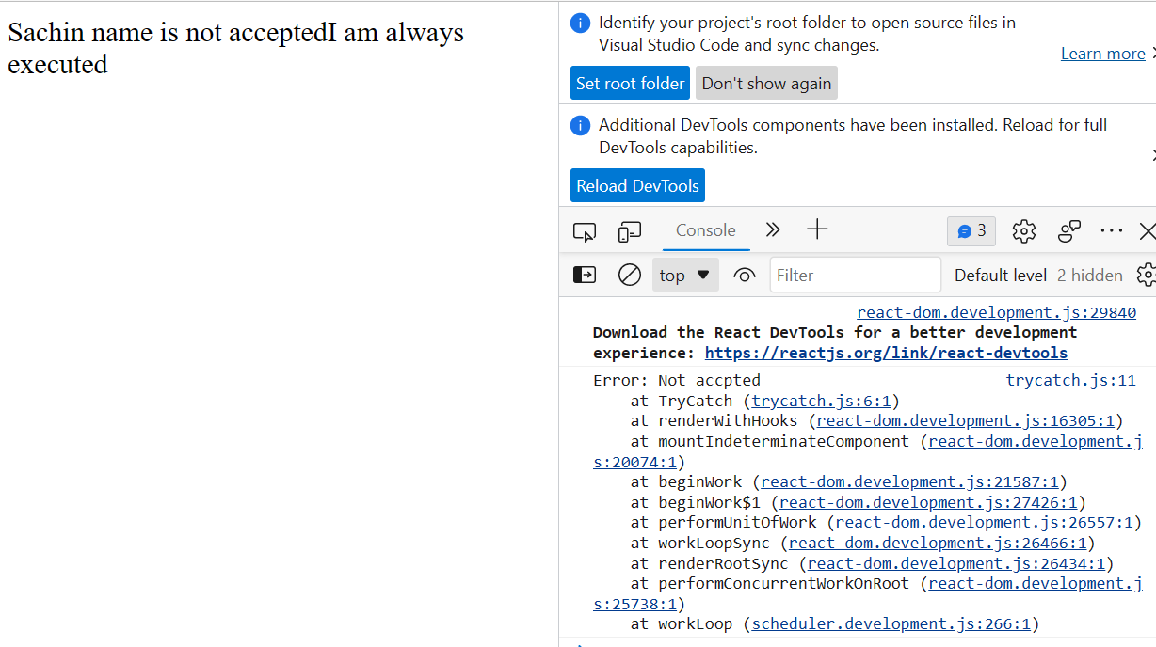
Output

Slide 22
Pure Component In React

Slide 23
Pure Component
By default, React will always re-render the component each time there is a change in state or props value.
A pure component is a component that only re-renders when its props or state change.
This means that if a pure component's props and state are the same as they were on the previous render, then the component will not re-render.
This can improve the performance of your React application

Slide 24
In simple words, If the previous value of state or props and the new value of state or props is the same, the component will not re-render itself.
Since Pure Components restricts the re-rendering when there is no use of re-rendering of the component.
Pure Components are Class Components which extends React.PureComponent.

Slide 25
Example 1
import React from 'react';
export default class Example extends React.PureComponent{
render(){
return <h1>I Love India</h1>;
}
}

Slide 26
Example 2

Slide 27
setState is called and the value of “counter” is set to the same value.
When setState is called, the component is re-rendered.
In this scenario, the updated component view remains the same.
There is effectively no difference in the UI — the new values are unchanged. Re-rendering, in this case, is an overhead.

Slide 28
class ImpureComponent extends React.PureComponent {
constructor() {
super();
this.state = {
counter: 0
}
// The value of Counter is updated to same value during continues interval
setInterval(() => {
this.setState({
counter: 0
});
}, 1000);
}
render() {
// This function wont be re-rendered in case when the new state is same as previous
return <b>Counter Value: {this.state.counter}</b>
}
}

